Slide 1
Artificial Intelligence as Representation and Search
하 진 영
강원대학교 컴퓨터공학과

Slide 2
A proposal for the Dartmouth summer research project on Artificial Intelligence (url IIa).
We propose that a 2 month, 10 man [sic] study of artificial intelligence be carried out during the summer of 1956 at Dartmouth College in Hanover, New Hampshire. The study is to proceed on the basis of the conjecture that every aspect of learning or any other feature of intelligence can in principle be so precisely described that a machine can be made to simulate it. An attempt will be made to find how to make machines use language, form abstractions and concepts, solve kinds of problems now reserved for humans, and improve themselves. We think that a significant advance can be made in one or more of these problems if a carefully selected group of scientists work on it together for a summer.
J. McCARTHY, Dartmouth College
M.L. MINSKY, Harvard University
N. ROCHESTER, I.B.M Corporation
C.E.SHANNON, Bell Telephone Laboratories
August 31, 1955

Slide 3
Main topics for discussion at the AI conference, Dartmouth College 1956 (url IIa).
Automatic Computers
How Can a Computer be Programmed to Use a Language
Neuron Nets
Theory of the Size of a Calculation
Self-Improvement (Machine Learning)
Abstractions
Randomness and Creativity

Slide 4
Newell and Simon
ACM Turing Award Lecture, 1976
All sciences characterize the essential nature of the systems they study. These characterizations are invariably qualitative in nature, for they set the terms with which more detailed knowledge can be developed...
The study of logic and computers has revealed to us that intelligence resides in physical symbol systems. This is computer science’s most basic law of qualitative structure. Symbol systems are collections of patterns and processes, the latter being capable of producing, destroying and modifying the former. The most important property of patterns is that they can designate objects, processes or other patterns, and that when they designate processes they can be interpreted...

Slide 5
Newell and Simon (2)
ACM Turing Award Lecture, 1976 (continued)
A second law of qualitative structure for artificial intelligence is that symbol systems solve problems by generating potential solutions and testing them - that is by searching. Solutions are usually sought by creating symbolic expressions and modifying them sequentially until they satisfy the conditions for a solution.

Slide 6
Physical Symbol System Hypothesis
Assumptions to form the basis
Newell & Simon’s Argue, ACM Turing Award Lecture (1976)
Intelligent activity is achieved through the use of
Symbol patterns to represent significant aspects of a problem domain.
Operations on these patterns to generate potential solutions to problems.
Search to select a solution from among these possibilities.
The Hypothesis
justifies efforts to build intelligent machines
makes explicit the underlying assumptions of AI research

Slide 7
Physical Symbol System Hypothesis (2)
Knowledge Representation and Search
heart of modern research in AI
Critics
argue that intelligence is inherently biological and existential and cannot be captured symbolically, Winograd and Flores 1986
well-considered challenge to the dominant direction of AI research
Underlie nearly all practical and theoretical work in
expert systems, planning, and natural language understanding

Slide 8
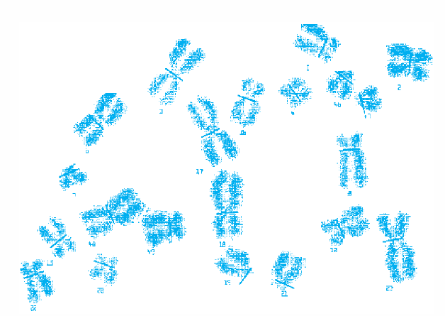
Knowledge Representation
Different representations of the real number
the real number: π
the decimal equivalent: 3.1415927...
the floating point representation:
Digitized image of chromosomes
array is natural representation
would be quite cumbersome using other representation such as predicate calculus
31416
1
exponent
mantissa

Slide 9
Knowledge Representation (2)
A representational scheme should:
be adequate to express all of the necessary information
support efficient execution of the resulting code
provide a natural scheme for expressing the required knowledge
McDermott, 1981
key to writing a successful knowledge-based program is the selection of appropriate representational tools
lower-level language (FORTRAN, etc) programmer fail in building expert systems simply because these languages do not provide the representational power and modularity required for knowledge-based programming

Slide 10
AI Representation Language
Must
handle qualitative knowledge
allow new knowledge to be inferred from a set of facts and rules
allow representation of general principles as well as specific situations
capture complex semantic meaning
allow for meta-level reasoning

Slide 11
AI Representation Language (2)
Handle qualitative knowledge
a blocks world
predicate calculus directly capture descriptive information
clear(c)
clear(a)
ontable(a)
ontable(b)
on(c, b)
cube(b)
cube(a)
pyramid(c)
c
a
b

Slide 12

AI Representation Language (3)
Allow new knowledge to be inferred from a set of facts and rules
for all X, there does not exist a Y, such that: Y is on X

Slide 13
AI Representation Language (4)
Allow representation of general principles as well as specific situations
use of variables
too restrictive assignment, type, and scope rules in traditional programming languages
highly dynamic handling in good knowledge representation languages

Slide 14
AI Representation Language (5)
Capture complex semantic meaning
large amounts of highly structured interrelated knowledge required
set of logical predicates
hassize(bluebird, small)
hascovering(bird, feathers)
hascolor(bluebird, blue)
hasproperty(bird, flies)
isa(bluebird, bird)
isa(bird, vertebrate)
semantic network description
explicitly denoted relationships
inheritance
vertebrate
hascovering
ISA
hasproperty
feathers
bird
flies
hassize
ISA
hascolor
small
bluebird
blue

Slide 15
AI Representation Language (6)
Allow for meta-level reasoning
an intelligent system
not only should know things (--> ability to solve problems)
but also should know what it knows (--> explain how it solved)
should be able to describe its knowledge in both specific and general terms
meta-knowledge
knowing about what you know
essential to the design and development of truly intelligent systems
AI representation languages
predicate calculus, semantic networks, frames and objects
LISP and PROLOG: languages for implementing the representations

Slide 16
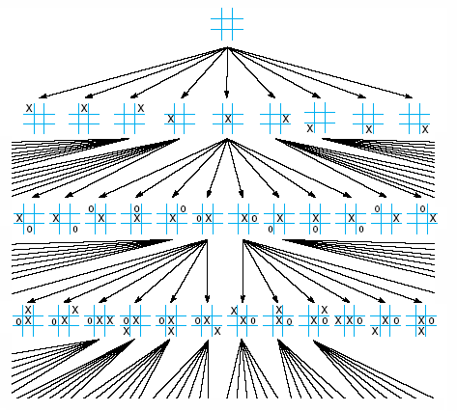
Problem Solving as Search
Second aspect of symbol system hypothesis
problem solving by searching
State space search: Tic-Tac-Toe game
node: collection of possible moves and responses
links: legal moves
state space graph

Slide 17
Portion of the state space graph for tic-tac-toe

Slide 18
Problem Solving as Search (2)
State space search
not, by itself, sufficient for automating intelligent problem-solving behavior
exhaustive search
10⁴⁷ State space complexity (Chess, 8x8 board size)
10¹⁷⁰ State space complexity (Go, 19x19 board size)
a number larger than the number of molecules in the universe or the number of nanoseconds that have passed since the “big bang”
heuristics
constitute one of the central topics of AI research
guide search along lines that have a high probability of success while avoiding wasted or apparently stupid efforts

Slide 19
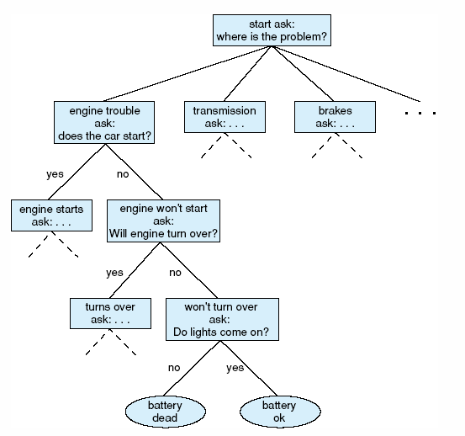
Problem Solving as Search (3)
State space description of the automotive diagnosis problem

